Slide 1



Team Name: Mighty Condas
Team Members:
Shanthi S Guru
Ankur Patel
Rekha Mishra
Ekta Upadhyay
Sindhu Nair
Mohit Pareek
Rajeev Sharma
Sachin Ralhan
05-04-2022
Notes:
Business problem statement: Metric of quantification – outputs
There are interested customers but we need to do this
5 min video on result documentation
Pandas Profiling – it’s a 1 line code

Slide 2
Overview of Problem Statement & Expectations
Project:
Mall Coupon selection – For increasing the customers in the Mall
Problem Statement:
To come up with a model which would be able to predict whether a customer will accept the recommended coupon issued from the mall to increase the footfalls in the restaurants and overall customers for the Mall.
Input Data:
We are provided with the historical data of the recommended coupons along with customer details of the previous years to help generate this model.
Output Needed:
After analysis and trying machine learning model team of data scientists is expected to come up with a model which would be able to predict whether a customer will accept a recommended coupon or not

Slide 3
Our Approach To Solve The Problem
Input Data
1. Understanding the Input Data & Data Cleaning
Labelled/ Unlabelled
Error free Data
2. Exploratory Data Analysis
Given data is Labelled
Unsupervised ML
Supervised ML
Insights & factors affecting Target variable
What to Predict ?
Class or Value ?
3. Feature Engineering & Label Encoding
Processed Data for Prediction Model
4. Model Selection
< Making Automated Functions for Deploying various classification Models>
Value
Class
Best suited Model for given Data
Regression Algorithms
Classification
Algorithms
5. Model Training & Evaluation
Logistic Regression
Gaussian NB
SVC
Decision tree classifier
Random Forest classifier
Gradient boost classifier
XG Boost Classifier
Performance metrics of each fitted Model
6. Final Prediction
F1-Score for Predictions

Slide 4
Step 1.1 – Understanding Data (Features)
Education
Occupation
Gender
Age
MaritalStatus
Has_Children
Destination
Weather
Temperature
Time
Direction_same
Direction_opp
Coupon_GEQ15min
Coupon_GEQ25min
Geographic Criteria
Demographic Criteria
Behavioral Criteria
Psychographic Behavioral Criteria
RestaurantLessThan20
Restaurant20To50
Passenger
Coupon
Expiration
Income
Bar
CoffeeHouse
CarryAway

Slide 5
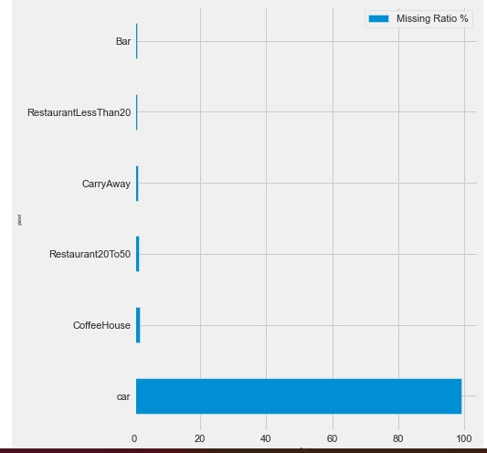
Step 1.2 –Data Cleaning
Team studied the each and every feature of the given data and had the following insights on it:
Car feature was found to have 99% null values and we decided to drop it
Similarly Coupon_GEQ5min was found to have only 1 value and it was also dropped
Other features with Null values were filled with Mode
Customer ID: It was found to be unique and no correlation was established so it has been removed

Slide 6
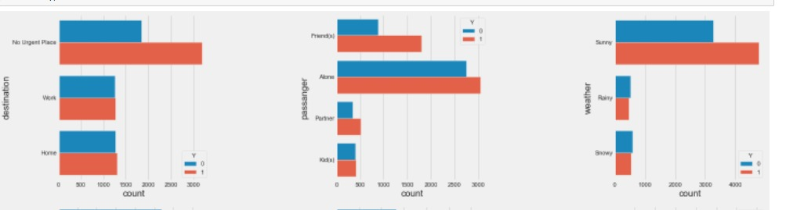
Univariate Analysis
Step 2 – Exploratory Data Analysis
Destination | Passenger | Weather

Slide 7
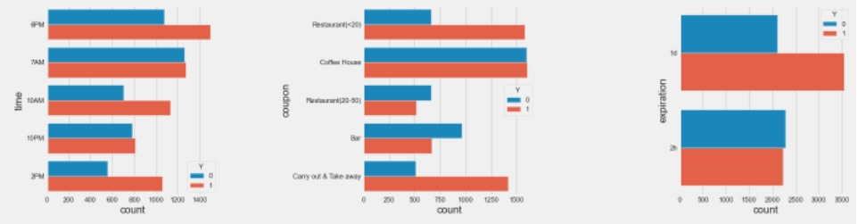
Step 2 – Exploratory Data Analysis
Univariate Analysis
Time | Coupon | Expiration

Slide 8
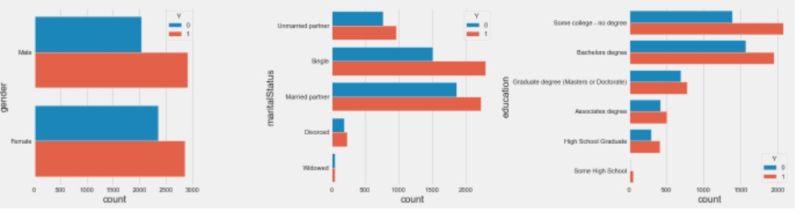
Univariate Analysis
Step 2 – Exploratory Data Analysis
Gender | Marital Status | Education

Slide 9
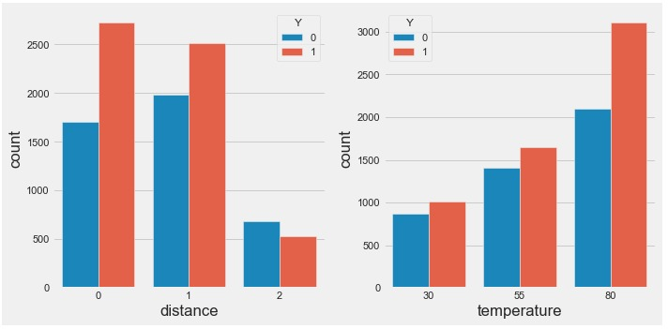
Univariate Analysis
Step 2 – Exploratory Data Analysis
Distance | Temperature
The plot shows some subtle, positive correlations between short distance, high temperature and the probability to accept the coupon.

Slide 10
Cross Tab Analysis
Step 2 – Exploratory Data Analysis
Destination: People that have no urgent place to be at have a higher probability to accept the coupon.
Passengers: If the passengers in car are friends of the driver, they are more likely to accept the coupon. Recommended Action: Drivers can be tied up with specific restaurant/s and they can refer the customer directly to that particular resto. Restaurants located near colleges where friends are more likely to visit together should offer more coupons/discounts for groups.

Slide 11
Cross Tab Analysis
Step 2 – Exploratory Data Analysis

Slide 12
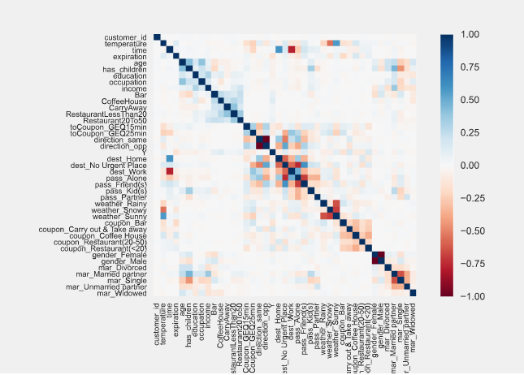
Co Relation Analysis
Step 2 – Exploratory Data Analysis
Positive Corelation found b/w:
Distance vs Temperature
Bar vs Restaurant20to50
Coffee vs Restaurantlessthan20
Negative Corelation found b/w:
direction_same vs direction_opp
Multi Co Linearity b/w:
Age vs has_children & Occupation
Hence Given Data Requires some further Feature Engineering to process in ML Model.

Slide 13
Business Insights based on EDA
Destination: People that have no urgent place to be at have a higher probability to accept the coupon.
Passengers: If the passengers in car are friends of the driver, they are more likely to accept the coupon.
Recommended Action: Restaurants located near colleges where friends are more likely to visit together should offer more coupons/discounts for groups.
Time: During the day when it is sunny, customers tend to accept more coupons from restaurants offering drinks etc.
Recommended Action: During sunny days, give coupons with combo offer of Food and Beverages
Same way later in the evening; restaurants offering liquor coupons are more likely to be accepted
Recommended Action: Introduce coupons / happy hours during evenings / weekends
Pricing: If the coupon is of a coffee house, the probability of accepting the coupon is just the same as rejecting it. If the coupon is of a cheap restaurant or carry out, most people will accept the coupon. If the coupon is of a Bar of expensive Restaurant, people tend to refuse it.
Coupon Validity: Coupons having longer validity are more likely to be accepted as they give flexibility to the customers.
Marital Status: Single people are more likely to accept the coupon.
Education: Some college, Bachelor or high school graduate are more likely to accept the coupon.
Recommended Action: Restaurants that are located in the geographical areas with higher concentration of such customers who are either residents or are working in the area should look at giving more discounts / coupons
Correlation: Besides, there are correlations among these frequency columns: Bar, CoffeeHouse, CarryAway, RestaurantLessThan20, Restaurant20To50
*Gender: There is no much difference based on gender.

Slide 14
Step 3. Feature Engineering & Label Encoding
Occupation: This feature had many numbers of values. Hence this was grouped into 4 main categories:
Student
Unemployed
Employed
Retired
These were label encoded to make them ordinal with hierarchy
New Features:
Age: Binning was done for age feature
toCoupon_GEQ15min: toCoupon_GEQ25min: These features were combined together to form a new feature: Distance
If 15 min was 0 then distance = 0
If 15 min was 1 and 25min = 0, distance = 1
If 25min = 1, then distance = 2
All other features were One Hot Encoded.

Slide 15
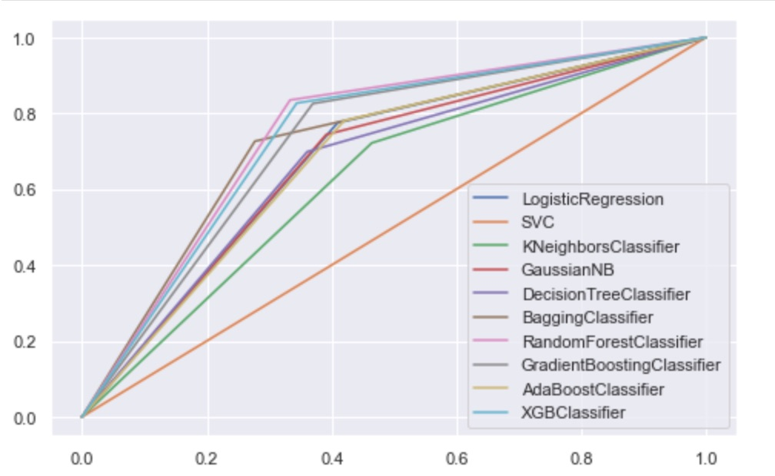
Step 4,5,6 – Model Selection , Prediction & Evaluation
Automated Function block for finding Best Fit Model:
Function Block
Step 4
Step 5
List of Classification Models
Get Best Parameters
Input file:
Processed Training Data
Perform Iterative Classification function
Get Model Performance Metrics
Plotting of ROC-AUC Curve
Choose Best Fit Model
Predict on given Test Data
Perform Prediction
Step 6
ROC-AUC Curve with different Models
Different Models were Tried on the Data,
Hyper Parameters Tuning was done for Top 3 Models further
XG Boost Classifier is observed as Best suitable Model for given Training & Test Data

Slide 16


Thank You to TSW-IIT R Team for this Hackathon !!!
Learnings from Hackathon :
Hands-on Experience for Real World Problem Solving.
Brainstorming of ideas & Exploring Insights from Complex Non-Linear Data.
Team Work to perform in Competitive environment
A Glimpse of our Hackathon 2 Journey:
< Don’t forget to have a Look into the Video >
Learn Together, Solve Together !!

